Slide 1
Chapter 4:
The Bill of Rights

Slide 2
Lesson 1: The First Amendment Pages 128-132
Vocabulary (6)
1. civil liberty
2. free speech
3. censorship
4. petition
5. slander
6. libel

Slide 3
Guaranteeing Civil Liberties
The first 10 amendments to the Constitution are known as the Bill of Rights which list the basic freedoms that all citizens of the United States have.
These freedoms are also called civil liberties.
The word civil means “relating to citizens.”
Having civil liberties gives citizens the power to have their own beliefs.
These liberties also give citizens the power to express themselves to others and to the government.
The First Amendment in the Bill of Rights protects five basic freedoms.

Slide 4
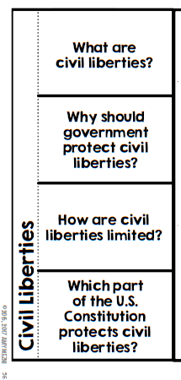
Guaranteeing Civil Liberties
Basic freedoms that all citizens have
Civil liberties give people the power to have their own beliefs and express them
Your rights should not harm others Examples-You may not tell lies about a person You can protest but not riot
The Bill of Rights protects civil liberties

Slide 5


Slide 6
The First Amendment protects five basic freedoms
1.Freedom of Religion
2. Freedom of Speech
The First Amendment protects religious freedom in two ways.
the government may not set up or support an official religion.
people are free to worship as they choose.
People can express themselves in words, music, art or dress without fear of being punished by the government
The First Amendment gives us the right to express ideas even if they offend other people.

Slide 7
The First Amendment
3. Freedom of the Press
4. Freedom of Assembly
People have the right to gather in group as long as they are peaceful
Meetings, parades, and protests are all forms of assembly.
We also have the right to associate with any group we want.
The government cannot censor the press.
This means that the government cannot tell the press what it can or cannot print or broadcast.
The press includes books, newspapers, magazines, radio, television, and the internet.
A free press is important in a democracy.

Slide 8
The First Amendment
5. Freedom to Petition the Government
People are able to make a formal request to the government.
It may be a statement signed by many people or a simple letter from one person.
A petition is a way to tell the government what you think.

Slide 9
The Bill of Rights Limits on Civil Liberty
The First Amendment rights given to all Americans DOES NOT allow citizens to do and say whatever they want.
Each person’s rights must be balanced against the rights of others.
Acting on your rights should not harm others or the community.
In order to protect the rights of everyone, the government places limits on our civil liberties.
Citizens are expected to use their rights responsibly.
This means that in using their individual rights they should not interfere with the rights of others.
Free speech gives you the right to criticize public figures.
It does not give you the right to tell lies about them.
Spreading lies that hurt someone’s reputation is a crime.
If the lies are spoken, the crime is called slander.
If the lies are printed, the crime is called libel.

Slide 10
Why limit civil liberties?
To protect the rights of the community.
To balance the rights of individuals.
Protect public safety
No one has the right to say or write anything that directly leads someone to commit a crime.
People have the right to march in protest, but not to riot.
Communities also have rights.
As a result, individual rights have to be balanced against the rights of the community.
When these are in conflict the rights of the community come first.

Slide 11
Lesson 2: Other Bill of Rights Protections Pages134-139
Vocabulary (9)
1. accused
2. probable cause
3. search warrant
4. indictment
5. double jeopardy
6. self-incrimination
7. due process
8. eminent domain
9. bail

Slide 12
Rights of the Accused
An important part of democracy is protecting the rights of people accused of crimes.
The Fourth, Fifth, Sixth, and Eighth Amendments protect the rights of the accused.
These amendments guarantee their right to fair legal treatment.

Slide 13
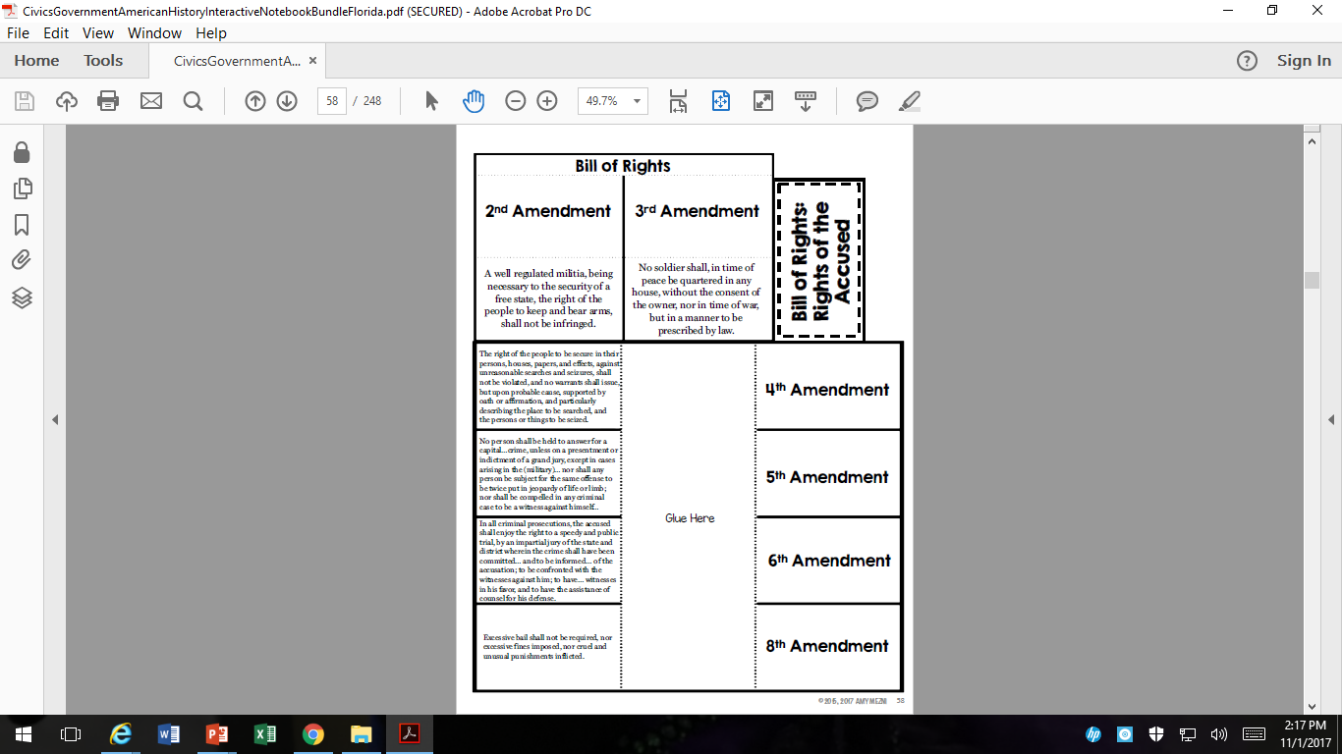

Slide 14
The Fourth Amendment
The Fourth Amendment has to do with searches.
No search and seizure without a search warrant.
A search warrant is a court order.
It allows the police to search a suspect’s home, business, or other property and seize, or take, evidence.
To get a search warrant, the police must convince a judge that they have probable cause to suspect a person of a crime.
Probable cause means to have a valid reason.

Slide 15
The Fifth Amendment
The Fifth Amendment says:
Citizens have the right to due process of the law
No one can be charged for a serious crime without an indictment (a formal charge from a grand jury.)
This is a group of citizens that looks at evidence to decide if a person may have carried out a crime.
No one can put on trial twice for the same crime.
No double jeopardy.
No one can be forced to testify against himself or herself.
No self-incrimination.

Slide 16
The Fifth Amendment
The Fifth Amendment protects many rights.
It protects every citizen’s right to due process of the law, for example.
Due process refers to the legal steps that must be followed before the government can take away a person’s life, freedom, or property.
The government has the power (eminent domain) to take away property to be used for the public if it pays for the property.
For example, the government cannot take a person’s house without paying a fair price it.

Slide 17
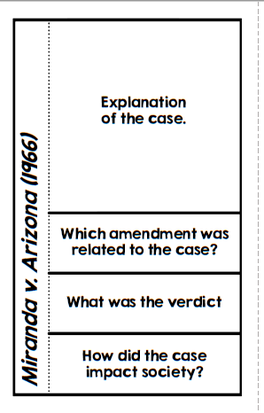
Miranda v. Arizona (1966)

Slide 18
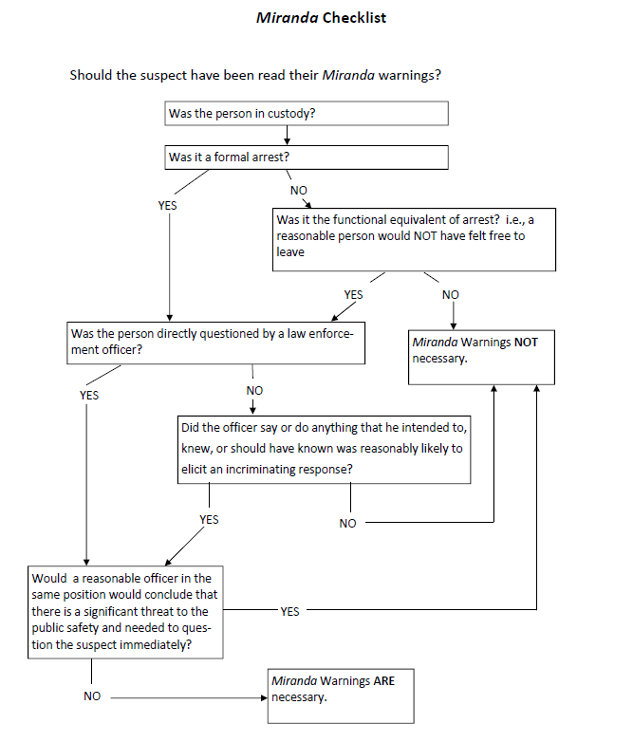
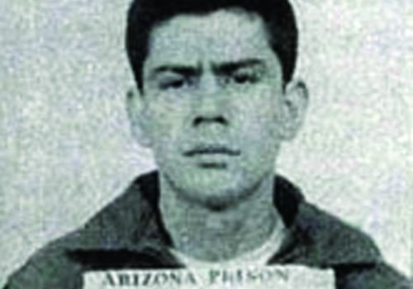
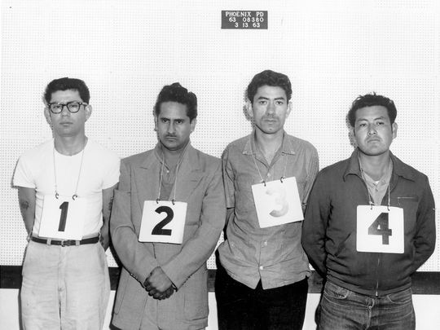
Miranda v. Arizona (1966)

Slide 19
Miranda v. Arizona (1966)
Ernesto Miranda was arrested for kidnapping and found guilty. Police questioned him without letting him know he had the right to remain silent or to speak to an attorney. He said his right to not incriminate himself was violated.
5th Amendment
Court ruled Miranda’s rights had been violated
Police must now use the Miranda warning when they arrest people to tell them what their rights are

Slide 20
The Sixth Amendment
The Sixth Amendment guarantees other rights to accused people.
People must be told the charges against them.
must be allowed a speedy and fair trial.
have the right to a public trial by a jury, or to be tried by a judge if they wish.
have the right to hear and call witnesses.
have the right to a lawyer.
If they can’t afford a lawyer, the government must pay for one.

Slide 21
The Eighth Amendment
The Eighth Amendment says that bail may not be set too high
Bail is a type of security deposit. It is money that an accused person pays to remain free while waiting for trial.
The Eighth Amendment also says no “cruel and unusual” punishments.
The question of what punishments are cruel and unusual is a matter of debate.

Slide 22
The Bill of Rights Additional Protections
When the Founders wrote the Bill of Rights they remembered the events that led to the American Revolution.
They felt that certain actions by the British government were wrong.
The Founders wanted to prevent the new American government from taking some of these actions.
As a result, the Second, Third, Seventh, Ninth, and Tenth Amendments were written to protect other rights of American citizens.

Slide 23
As a result, the Second, Third, Seventh, Ninth, and Tenth Amendments were written to protect other rights of American citizens.

Slide 24
The Second Amendment
The Second Amendment states that people have the right to “keep and bear arms.”
Government cannot stop people from owning guns but it can pass laws controlling sale and licensing of guns.
License-permission to own guns.

Slide 25
The Third Amendment
The Third Amendment says that
soldiers may not move into people’s homes without permission
This was important to early American colonists.
They were forced to house and feed British soldiers.

Slide 26
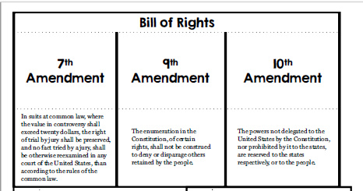

Slide 27
The Seventh Amendment
Deals with the rights of people involved in lawsuits (civil cases).
Civil cases are about disagreements between people rather than crimes.
Civil cases are tried in the courts.
The amendment guarantees the right to a trial jury in most of these cases.

Slide 28
The Ninth Amendment
people’s rights are not limited to what is in the Bill of Rights.
People retain, or hold on to, other rights as well.
The government may not deny those rights just because they are not spelled out in the Constitution.

Slide 29
The Tenth Amendment
any powers not given to the federal government belong to the states or to the people.
This is meant to keep the president and Congress from becoming too strong.
The government of the United States can have only the powers the people give it.

Slide 30
Lesson 3: Furthering Civil Liberties Pages 141-145
Vocabulary (3)
1. Black codes
2. Suffrage
3. Poll tax

Slide 31

Civil War Amendments
The Bill of Rights was meant to protect citizens from the power of the federal government.
States often passed laws that denied people’s rights. Example-women and African Americans could not vote.
On the next slides so don’t write anything!

Slide 33
Civil War Amendments
Slavery was legal in Southern states.
Enslaved African Americans had almost no rights at all and were often treated as property.
After the Civil War, three new amendments were added to the Constitution extending rights to African Americans.

Slide 34
The Thirteenth Amendment
13th Amendment-made slavery illegal.
Though slavery was against the law, many states still would not give African Americans basic rights.
Many Southern states passed laws called black codes which put strict limits on where freed slaves could live and what jobs they could do.

Slide 35
The Fourteenth Amendment
The Fourteenth Amendment protected the rights of the newly freed slaves and struck down the black codes.
14th Amendment-all people “born or naturalized in the United States” were citizens
which included most African Americans.
It said the states
gave all citizens “equal protection of the laws.”
must guarantee due process to all citizens.
Since that time, the “equal protection” part of the Fourteenth Amendment has helped women and other groups gain equal rights.

Slide 36
The Fifteenth Amendment
The Supreme Court has also said that the “due process” part of the fourteenth amendment makes the Bill of Rights binding on the states.
It means that American citizens in every state have the same basic rights.
15th Amendment-extended suffrage, or the right to vote, to African Americans.
male African Americans have the right to vote.
State laws still kept women from voting in most elections.

Slide 37

Electoral Process and Voting Rights
The Constitution was amended several more times in the 1900s.
Some new amendments extended the right to vote to more people.
Others changed the way elections were carried out.

Slide 38
The Seventeenth Amendment
(1913) U.S. Senators directly elected by citizens of their state.
Up until then, members of the Senate were chosen by the legislatures of their states.
The Seventeenth Amendment says that people will elect their senators directly.

Slide 39
The Nineteenth Amendment The Twenty-Third Amendment
19th Amendment
(1920) women have the right to vote.
Most states did not allow women to vote.
23rd Amendment
(1961) people living in Washington, D.C. can vote for president and vice president
“D.C.” stands for the District of Columbia.
Because this area is not part of any state, its residents could not vote in national elections.
But even today they do not have representatives in Congress.

Slide 40
The Twenty-fourth Amendment The Twenty-sixth Amendment
24th Amendment
(1964) eliminated poll taxes.
A poll tax is a fee that is charged for voting.
Southern states used poll taxes to keep poor people from voting.
Many people could not pay them.
26th Amendment
(1971) lowered the voting age to 18 years of age.
Before then, most states had set the minimum age for voting at 21.

Slide 41
